Slide 1
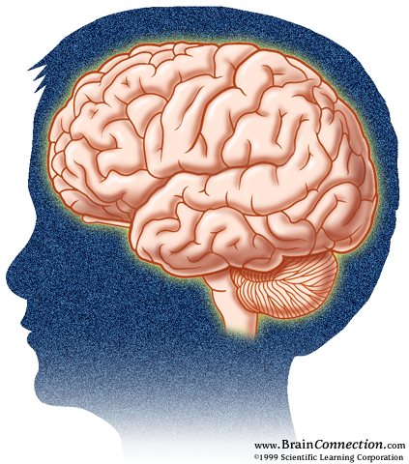
KNOW your BRAIN
Rohit Seth, Ph.D.
Department of Zoology
Guru Ghasidas Vishwavidyalaya

Slide 2
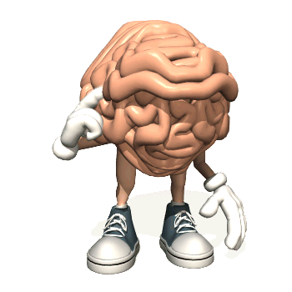
HOW our BRAIN work ??????????????
Thinking about Thinking

Slide 3
The Science that tells HOW our BRAIN work
Your brain, spinal cord and peripheral nerves make up a complex, integrated information-processing and control system known as your central nervous system
The scientific study of the brain and nervous system is called neuroscience or neurobiology.

Slide 4
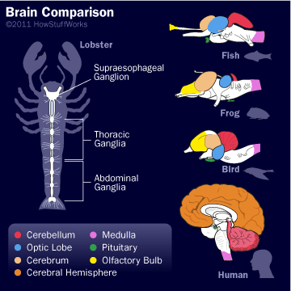
Cerebellum
Medulla
Optic Lobe
Cerebrum
Optic Bulb

Slide 5
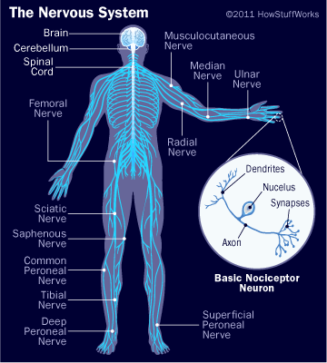
THE NERVOUS SYSTEM
CENTRAL
PERIPHERAL

Slide 6
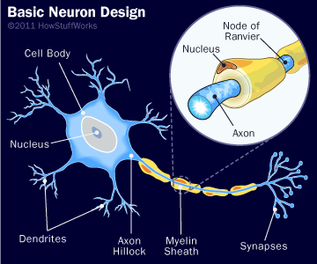
BRAIN CELLS

Slide 7
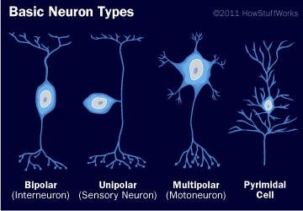

Slide 8
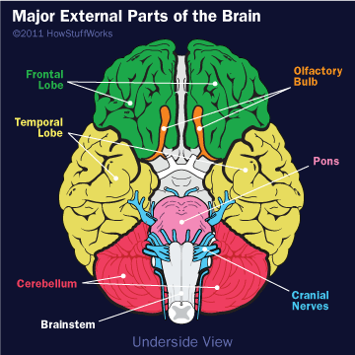
MAJOR DIVISIONS
OF
THE BRAIN

Slide 9
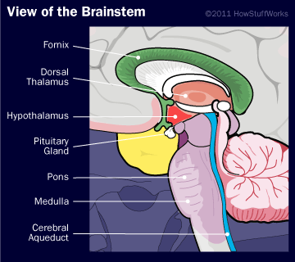
THE BRAINSTEM

Slide 10
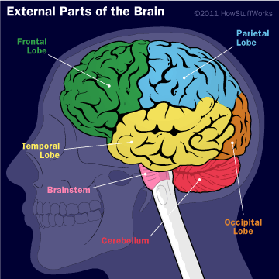
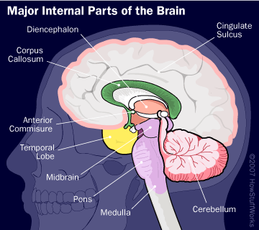
EXTERNAL AND INTERNAL BRAIN

Slide 11
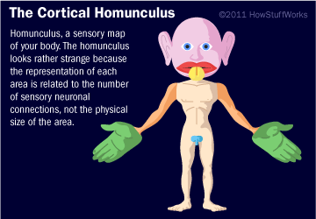
THE HOMUNCULUS

Slide 12
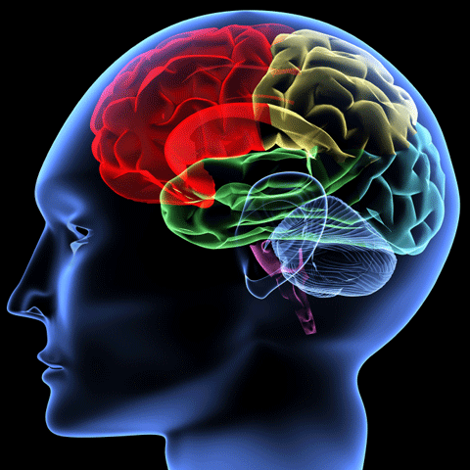
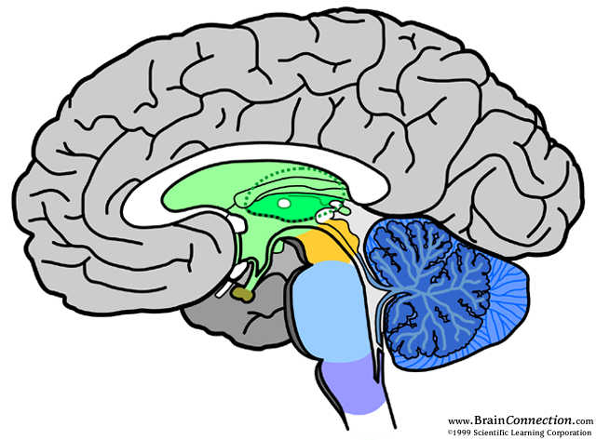
The Limbic System
Hippocampus
Cerebellum
Hippocampus
Amygdala
Amygdala
Cerebellum

Slide 13

Amygdala
Gatekeeper
Three levels of attention
The need to BELONG
The need to be SAFE

Slide 14

The Hippocampus
Transferring memories
Making new memories
Inhibition
Smell
Location

Slide 15
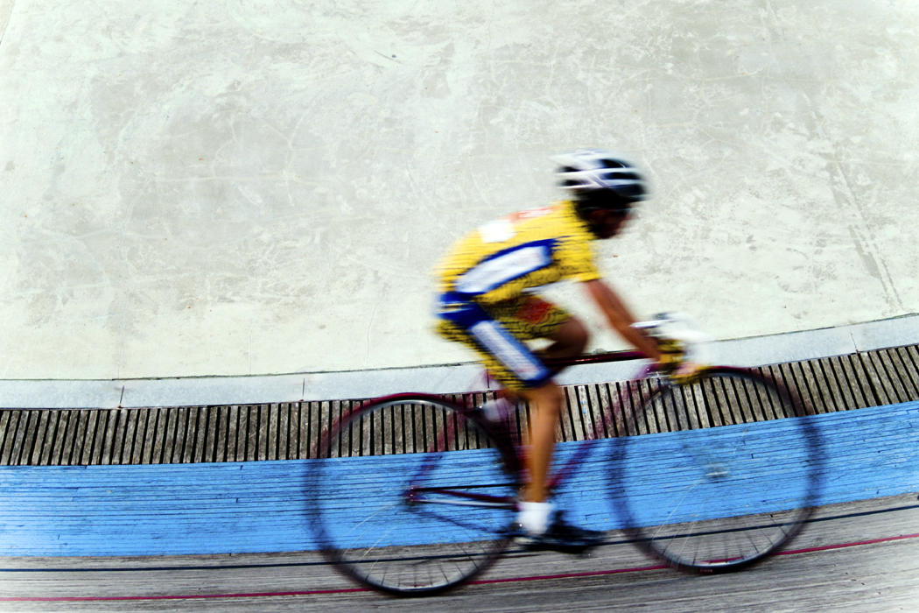
The Cerebellum
Movement
Balance

Slide 16
The Cerebellum
“It's like a math co-processor. It's not essential for any activity ... but it makes any activity better. Anything we can think of as higher thought, mathematics, music, philosophy, decision-making, social skill, draws upon the cerebellum....” Dr. Jay Giedd, National Institute of Mental Health

Slide 17
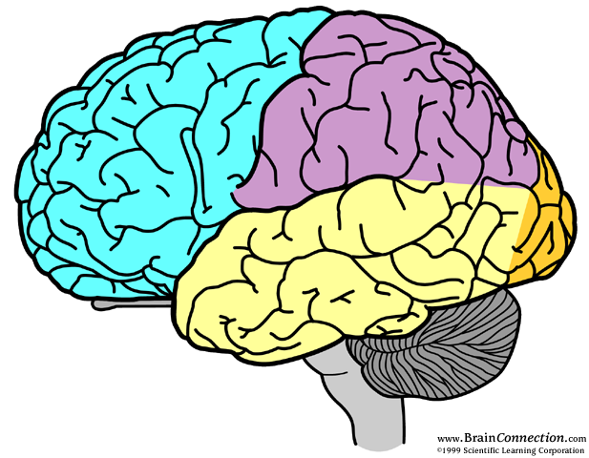
The Cerebrum
Parietal lobe
Frontal
lobe
Occipital
lobe
Temporal
lobe
Cerebellum
Notes:
The superior brain – unique to man
4 lobes: frontal, parietal, occipital, temporal

Slide 18
The Frontal Lobe
  How we interact with our surroundings.
  Our judgments on daily routines.
  Our expressive language.
  Assigns meaning to words we choose.
  Involves word association.
  Memory for habits and motor activities

Slide 19
The Parietal Lobe
  Location for visual attention.
  Location for touch perception.
  Goal directed voluntary movements.
  Manipulation of objects.
  Integration of different senses that allows for understanding a single concept.

Slide 20
The Occipital Lobe
Vision

Slide 21
The Temporal Lobe
  Hearing
  Memory
  Visual perceptions.
  Categorizing of objects.
T

Slide 22
Higher Level Thinking
Using the Gray Matter!
Can actually generate NEW neurons (neurogenesis)
Adds dendrites
Increases the thickness of the myelin sheath
Notes:
Studies show neurogenesis in the hippocampus – has a lot to do with memory, moving from short-long term memory
Adding dendrites means more connections can be made
Increasing myelin sheath makes connections faster

Slide 23
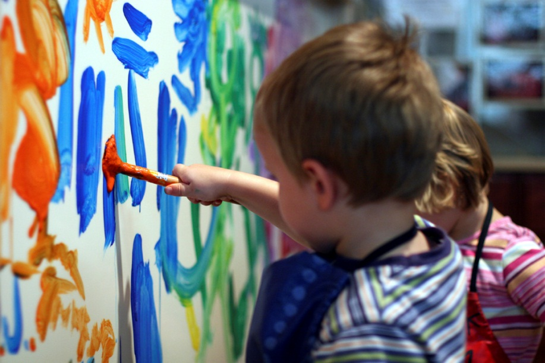
Stimulating Environment Affects Learning
A child's ability to learn can increase or decrease by 25 percent or more, depending on whether he or she grows up in a stimulating environment.
www.brainconnection.com

Slide 24
Two times of ENORMOUS brain growth and pruning:
During the first month of life, the number of connections or synapses increases from 50 trillion to 1 quadrillion.
If an infant's body grew at a comparable rate, his weight would increase from 4 Kilogram at birth to 85 Kilogram when one month old.
Overproduction ends, pruning begins until about age 3

Slide 25
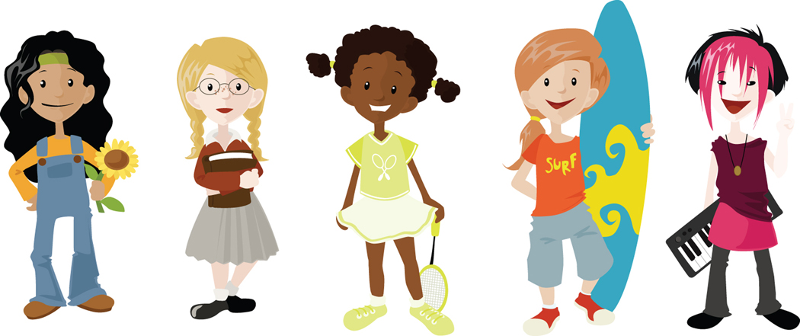
Second cycle of growth and pruning
Dendritic growth spurt at age 11 in girls, 12 in boys
Pruning phase during adolescence
Age 13 – 18 lose 1% of gray matter per year
If you don’t use it, you lose it!

Slide 26
Sad Fact:
Use it or lose it: If dendrites are not being used, they will be pruned.
Failing to engage students actively can actually make students dumber.

Slide 27
Implications for my Classroom
Interactive instead of didactic!!!
Access prior knowledge
Add new knowledge using many modalities
Apply knowledge in a variety of ways
Assess and summarize

Slide 28
Active Engagement
In Learning
Grow
Dendrites
More neurons
firing

Slide 29
This is Your Brain.
This Is How It Works.

Slide 30
SOME MORE INTERESTING
FACTS

Slide 31
OTHER BRAIN CELLS

Slide 32
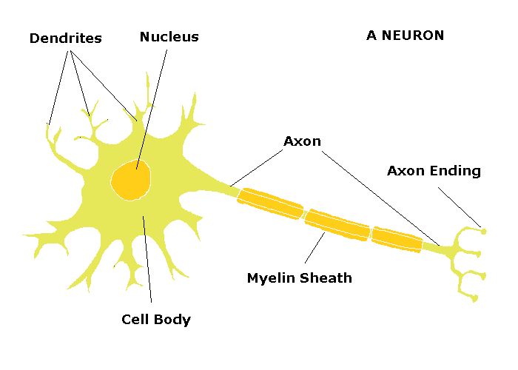
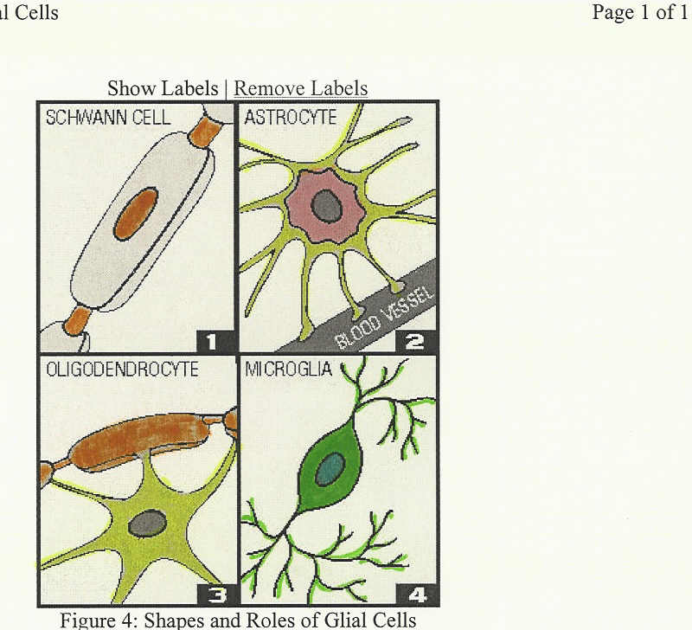
FUNCTIONAL STRUCTURAL
NEURONS ASTROCYTES
OLIGODENDROCYTES
MICROGLIA
EPENDYMAL CELLS

Slide 33
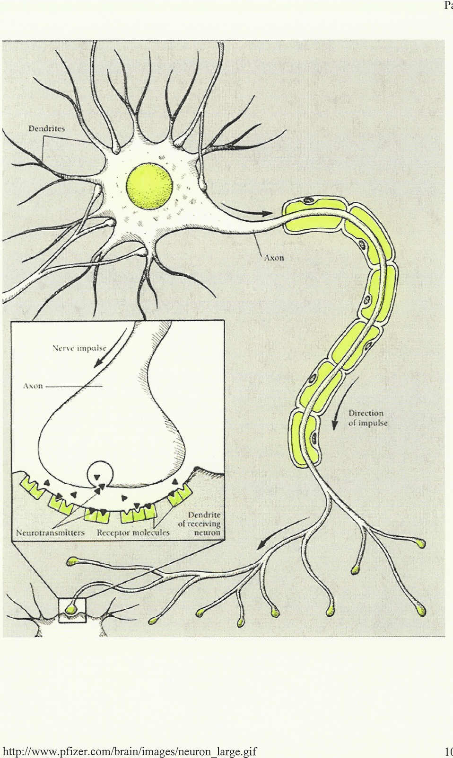
SYNAPSE

Slide 34
CRANIAL NERVES
I – Smell
II – Visual fields
III – Pupil, lid and eye movements
IV – Eye movement
V – Face sensation (TIC)
VI – Eye movement
VII – Face movement (Bells’ palsy)
VIII – Hearing, balance, equilibrium
IX/ X – Gag & swallow plus lots more
XI – Scapula position, neck movement
XII – Tongue thrusting

Slide 35
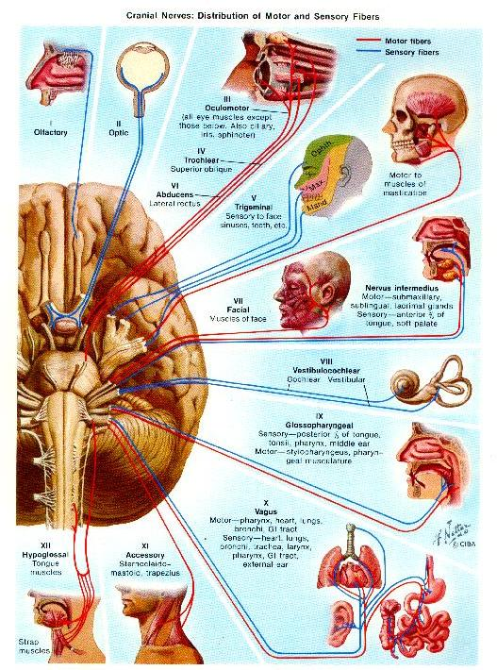
THE CRANIAL NERVES

Slide 36
Taking sides….two sides that is!
Two sides or hemispheres of the brain: LEFT and RIGHT
We have two cerebral hemispheres connected by the corpus callosum. This is a bundle of nerves that allows each side of the brain to communicate with each other.
Each side of the brain processes things differently.
It is an outdated assumption that “artsy” type people are right-brained.

Slide 37
Taking sides…. how the two sides process information that is!
Left Brain
Logical
Sequential
Rational
Analytical
Objective
Looks at parts
Right Brain
Random
Intuitive
Holistic
Synthesizing
Subjective
Looks at wholes

Slide 38
Left Hemisphere
    processes things more in parts and sequentially
    recognizes positive emotions
    Identified with practicality and rationality
    Understands symbols and representations
    Processes rapid auditory information faster than the right (crucial for separating the sounds of speech into distinct units for comprehension)
    is responsible for language development. It develops slower in boys, that is why males usually develop more language problems than females.

Slide 39
Right Hemisphere
    Recognizes negative emotions
    High level mathematicians, problem solvers, and chess players use
    The “non-verbal” side
    Responds to touch and music (sensory)
    Intuitive
    Responsive to color and shape
    Emotional and originative

Slide 40
Taking sides…. what information the two sides recognize!
Left Brain
Letters
Numbers
Words
Right Brain
Faces
Places
Objects
based on Sousa (1995, p. 88)

Slide 41


Slide 42
HOW THE BRAIN WORKS
What makes us think differently?

Slide 43
HOW THE BRAIN WORKS
What makes us think differently?
What makes a person a “wolf?”

Slide 44
HOW THE BRAIN WORKS
What makes us think differently?
What makes a person a “wolf?”
What is the biblical definition of “Election?”

Slide 45
Everyone is right in their own sight!

Slide 46
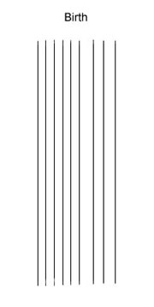
THOUGHT PATTERNS

Slide 47
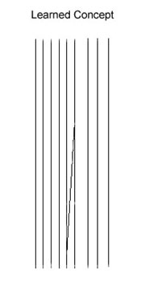
THOUGHT PATTERNS

Slide 48
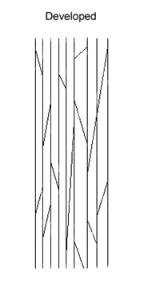
THOUGHT PATTERNS

Slide 49
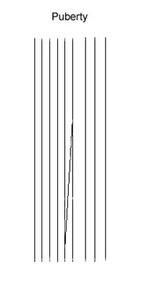
THOUGHT PATTERNS

Slide 50
I Corinthians 13:11
When I was a child, I used to speak like a child, think like a child, reason like a child; when I became a man, I did away with childish things.

Slide 51
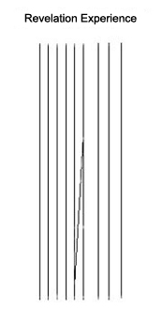
THOUGHT PATTERNS

Slide 52
References
Bandura, A.(1994). Social learning theory. From Theory into practice database. (Kearsley, G.).
Bloom's Taxonomy: (2003).
Chicurel, M. (1995) The Inner Life of Neurons, retrieved on-line.
Doolittle, P. (2001). Multimedia Learning: Empirical Results and Practical Applications .
Gaines, B.R. & Shaw, M. (1995). Collaboration Through Concept Maps.
Sousa, D. R. (1995). How the Brain Learns. Reston, VA: NASSP

Slide 53
Any Questions?

Slide 54
THANK YOU

